Slide 1


Slide 2




Objectives
Focal point
for research and development
Development
of capability and skills
Mutual collaboration
in research and development

Slide 3
Types & Allocation of Grant
U.S. Senior Specialist Grant
Up to 6 weeks assignment in Malaysia
U.S. Senior Researcher Grant
Up to 5 months research in Malaysia
Malaysian Senior Researcher Grant
Malaysian Graduate Study Grant
Up to 2 years study in U.S. for Masters & PhD
Up to 5 months research in U.S.
Total Grant : Maximum of RM1million per annum for period of 2015 to 2019

Slide 4
Research Areas
Digital Civil Society
Communications and Multimedia Technology
Regulatory and Policy
Convergence & Broadband Strategy • Economics & Competition •
Standards & Interoperability •
Resource-Spectrum Scarcity •
Cyber Security & Forensic •
Policy and Legislation •
• New Media & Social Impact
• Safeguarding Youth
• Nation Building
• Good Citizenry
• Media Literacy
• Outreach Programs
Network Infrastructure • • Mobile & Wireless
Emerging Technologies • • Information & Network Security
Digital Broadcasting • • Information Technology
• Programming & Communications System

Slide 5
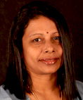
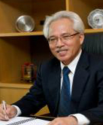
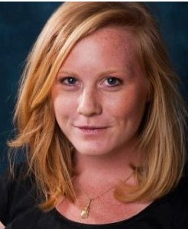
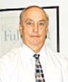

PROJECT & RESEARCH SHOWCASES
  Digital Civil Society
Technology Areas
Assoc. Prof. Shanthi Balraj
Universiti Sains Malaysia
Encik Wan Azrain Adnan
Vice President of Business Development
mTouce Bhd.
Regulatory and Policy
U.S. Researcher
Prof. Dato Dr. Muhamad Rasat Muhamad President
Multimedia University
Ms. Claire Elizabeth Cravero
John Hopkins University
Fulbright Overview
Speak with the Fulbrighters
Dr. James Coffman
Director
MACEE
Fulbright Alumni Association of Malaysia (FAAM)

Slide 6



