Slide 1
Digital Lifeworlds, Diversities and Media Literacy Designers in Malaysia.
Shanthi Balraj Baboo
School of Arts
Universiti Sains Malaysia

Slide 2
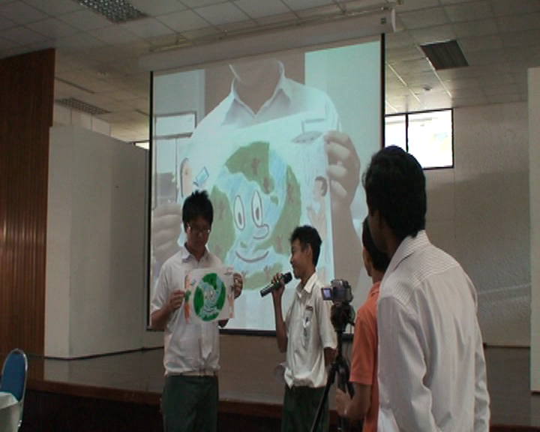
The Malaysian Media Environment
Complex social context
Meaning making in different cultural,
social or domain-specific contexts.
Actively involved in shaping and construct media stories & images
Confronting pleasures, controversies, opportunities & risks, sensible & irresponsible behavior.
Race, Religion, Rulers sensitivity

Slide 3
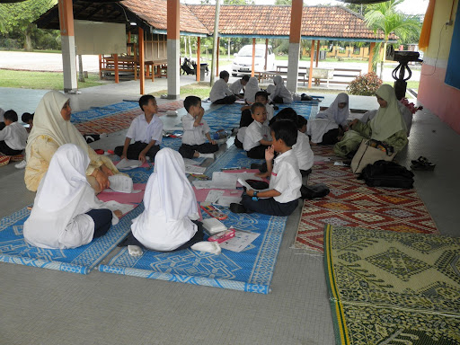
Digital Lifeworlds: Selected Research projects(2005-2014)
Growing up with new media (10 age group)
Young People & Uses of New Media (13-15 & 16-18 age groups)
Captivated by Facebook (18-22 age group)
New media & political orientations of young people (19-25 age group)
Video Critical (14-16 age group)
Creative Media Projects (16 age group)
Access & Outlook
Media use
Media experiences
Key Skills

Slide 4
Growing up with new media (10 age group)
Media practices begin & take place at home – role of parents & siblings
First started using new media devices first around 5-7 years.
Internet, Television and listening to music are top leisure activities
Game Players
Creating and sharing content (video, music)
Language learning & online tuition
School projects: cut & paste & download video, music & images

Slide 5
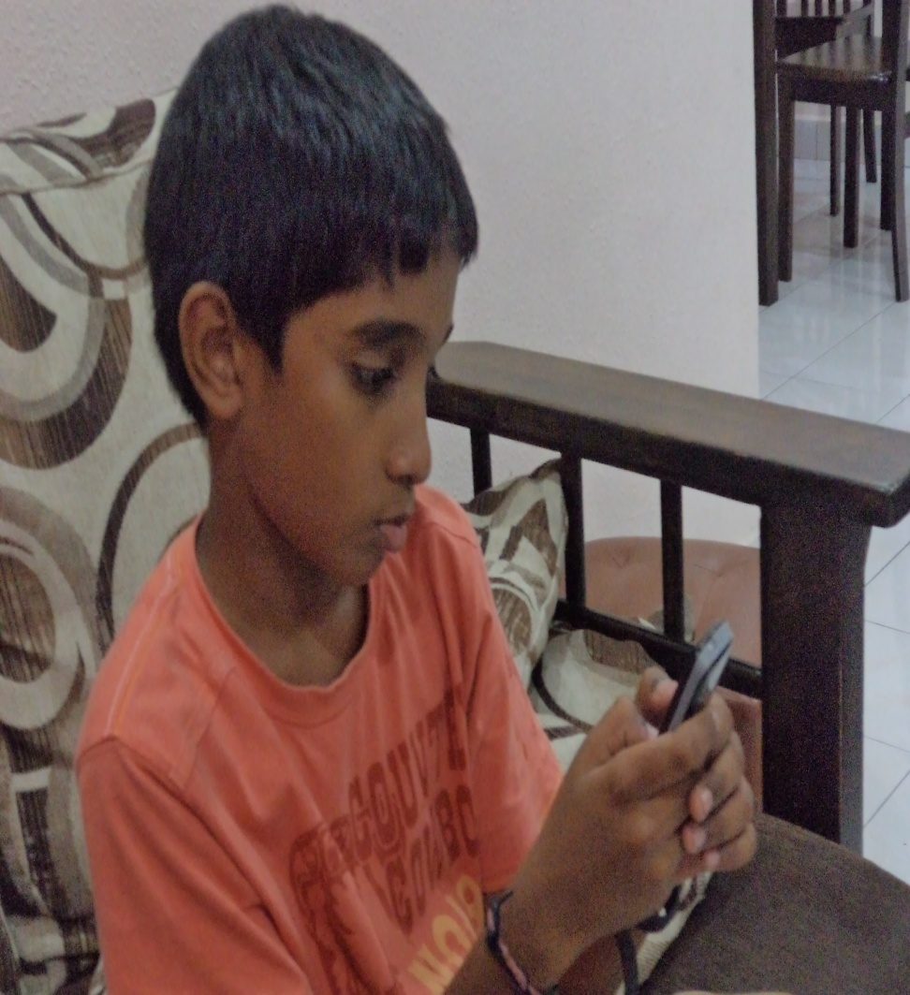
Growing up with new media (10 age group)
Social media (Facebook – most visited site)
Children tend to post pictures in Facebook
Chat with friends (makes them happy, tell friends about daily happenings)
Often encounter sexual images online.
Never or rarely change their passwords regularly
Not sure about what is true and false.
Tend to believe many materials that they read and watch (news, wikis, web sites, blogs, You Tube).
A ‘gap’ between in-school and out-of-school literacies.

Slide 6
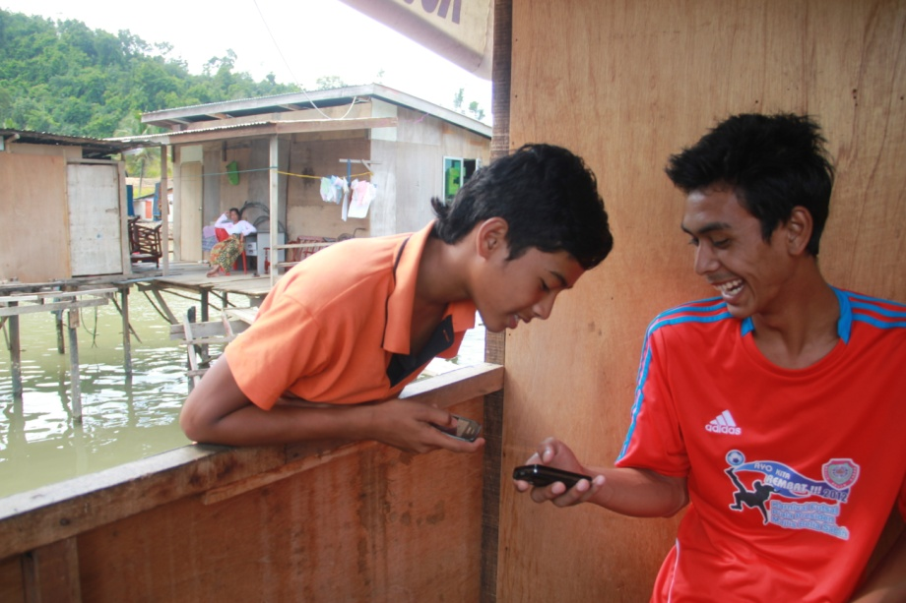
Young People & Uses of New Media (13-15 & 16-18 age groups)
Most of the Internet use, gaming and mobile phone usage take place at the home.
Self-learning is the most popular way of learning to use new media
Popular media activities include phoning and texting, social networking and playing new media games
Difficult to do everyday activities without a mobile phone
New Media do not affect quality time with the family

Slide 7
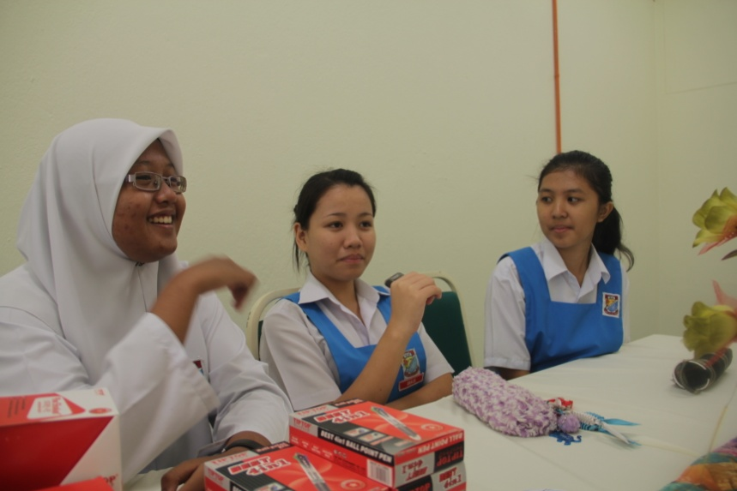
Young People & Uses of New Media (13-15 & 16-18 age groups)
Do research, school work, news and other information gathering (Wikipedia, Google).
Feel like a freak without doing Facebook
Facebook is very popular (keeping in touch, flirting & gossiping)
Privacy, bullying & harassment is highly prevalent
Risky behavior: play & joke with strangers
Receiving online information, jokes and advice that appear biased or racist
Uncertainty - privacy and moral issues as NOT seen as serious

Slide 8
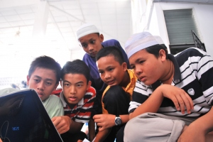
Young People & Uses of New Media (13-15 & 16-18 age groups)
Addiction to new media
No (aware of time management)
Yes (cannot control, a lot of time wasted –like a drug)
Mostly not addicted to online gambling
Lack of knowledge on information that is posted in terms of its permanence and the possibility of the information being saved and used for other purposes
Only a moderate number of the respondents say that they can evaluate the quality, relevance on accuracy of information

Slide 9
Young People & Uses of New Media (13-15 & 16-18 age groups)
Not reporting to parents or teachers when receiving hateful content or when someone threatens in a chat room
Many parents never control the use of their children’s mobile phones or pose rules and conditions for using the Internet
Gap between parents and young people: control time but don’t know types of content and materials; online acquaintances
Parents never talk about online security, risks and challenges and media violence at home.
Teachers never talk about online security, risks and challenges and media violence at school.

Slide 10
Captivated by Facebook (18-22 age group)
Concerned about the amount of attention they receive on Facebook - the number of ‘like’, ‘share’, ‘comment’, ‘friends’
Do multiple personalities on Facebook.
Talk about personal issues on Facebook. (Yes - 25.5%)
Have physically dated someone whom I met on Facebook (Yes - 24.5%).
Share my Facebook password with my boy/girlfriend. (Yes - 25.2%)

Slide 11
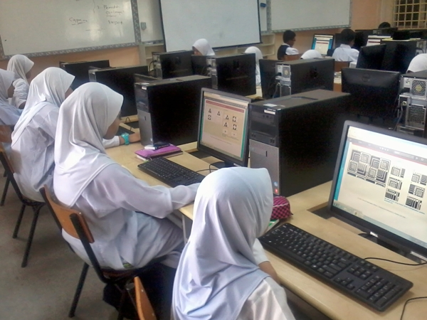
Captivated by Facebook (18-22 age group)
Pleasures
Engage interest and drama in everyday routine
Express oneself creativity
Experiment with identity
Difficulties
Distraction
Productivity (Study/Work) is affected
Misunderstanding
Posts and Comments misinterpreted
Friendship damage
Information on Facebook-
trustworthy?
What to share? Not to share? who to choose to share with?

Slide 12
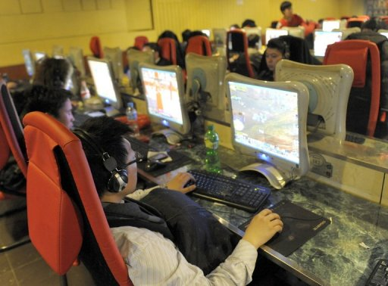
Captivated by Facebook (18-22 age group)
Difficulties
Uncertainty in the ways young people view private, personal and public
Revealing information on their whereabouts when they 'check-in' at locations
Uncertainty on how young people evaluate information
Differentiating between fact and fiction
Insensitive responses, Disturbing responses, rude comments & postings

Slide 13
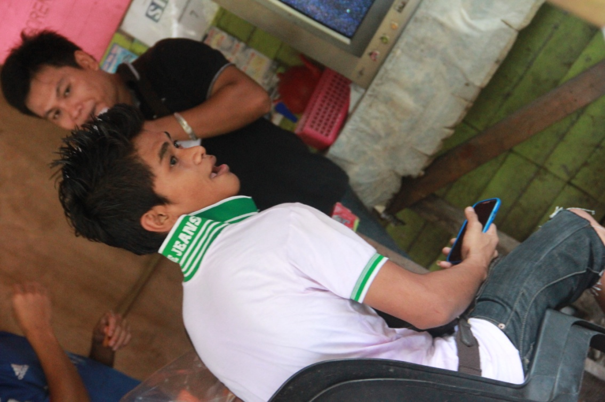
Captivated by Facebook (18-22 age group)
Rural Sabah & Sarawak
Digital Age is slow
Internet and Broadband Facility
unavailable in several rural areas
Available only in ‘Pekan’ or public schools (unstable)
Missing out and coping to get into the digital age
Not allowed to bring laptops to schools
Low knowledge on education, business & development
Low knowledge on opportunities, safety & risks
Dealing with social infrastructure (awareness, knowledge, access to information)

Slide 14
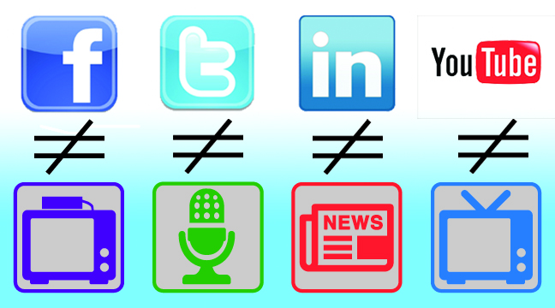
New media & political orientations of young people (19-25 age group)
Values and vision important in today's political arena:
Social redistribution, democracy, national unity, strong economy, corruption-free, social freedom, education, crime-free, lower cost of living
Political consciousness
Followed political groups/individuals in Facebook
Have taken part in political gatherings
Real time action (petition, rally, campaigning, observer)
Important players that can contribute to social change
Difficulties
Negative perception towards mainstream media- biased
Problems in determining reliable sources
Trouble in distinguishing facts between news from mass media and Facebook news
Hard to verify what is consumed online
Little skills and critical inquiry when evaluating video materials on Facebook

Slide 15
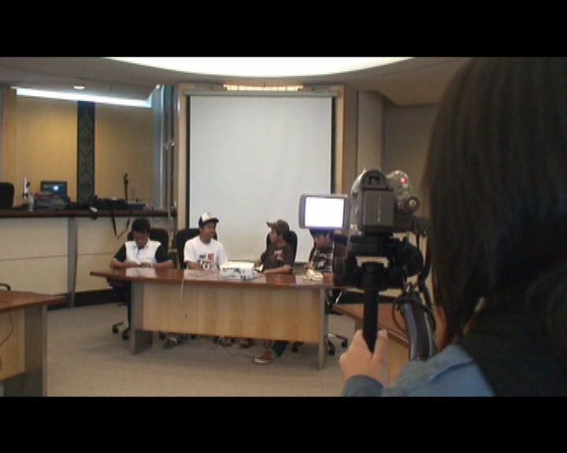
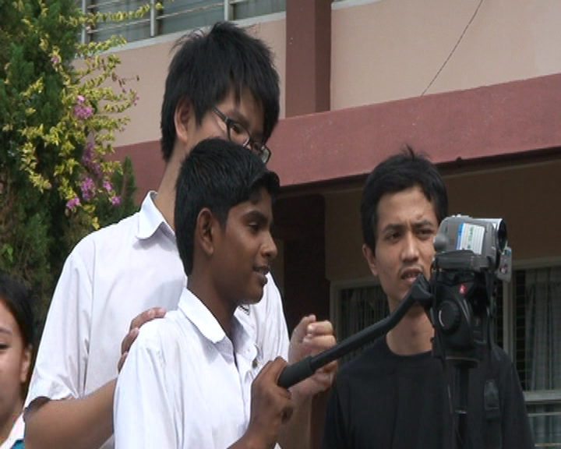
Video Critical (14-16 age group) Creative Media Projects (16 age group)
Young people enjoy making video
Production skills (acting, camera angles, editing, creative techniques)
‘sit back & watch’ to ‘make & do’
Learnt about storytelling and whose view gets selected
Critical analysis & thinking
Giving voice
Uploading & sharing

Slide 16
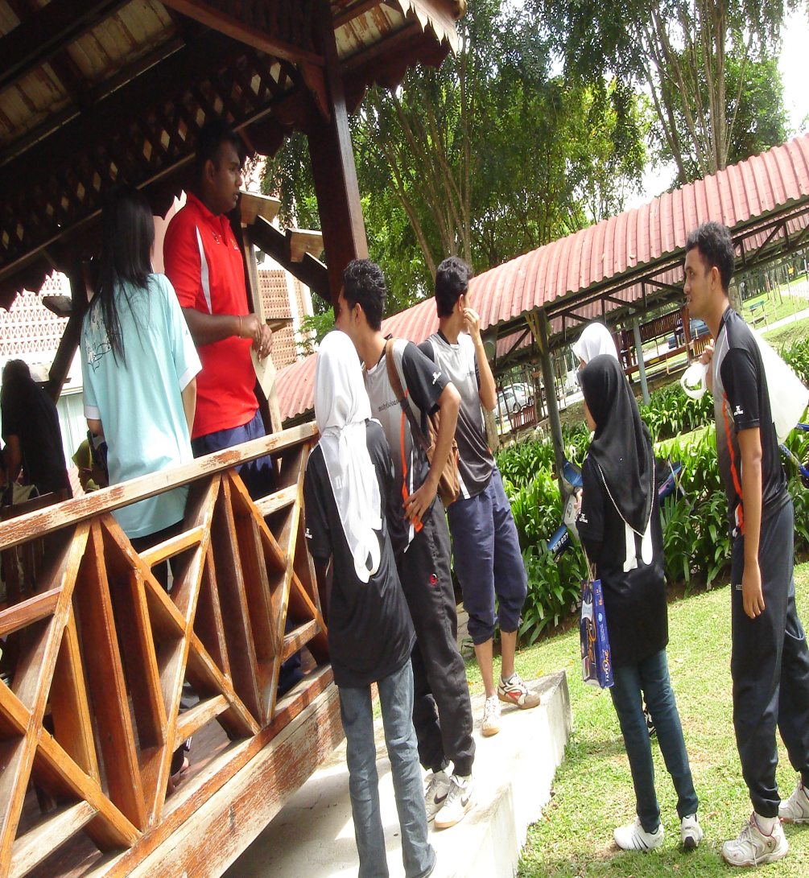
Diversities Research Summary Findings:
Skills are varied & unequally distributed
Gap between in-school and out-of-school learning experiences
Parents do not regulate media use
Self-learning
Trustworthiness and Image Manipulation, politics & cyberspace
Limited knowledge on opportunities
Risky encounters
Cyber bullying, stalking, sexually explicit texts
Hurtful words & hate talk

Slide 17
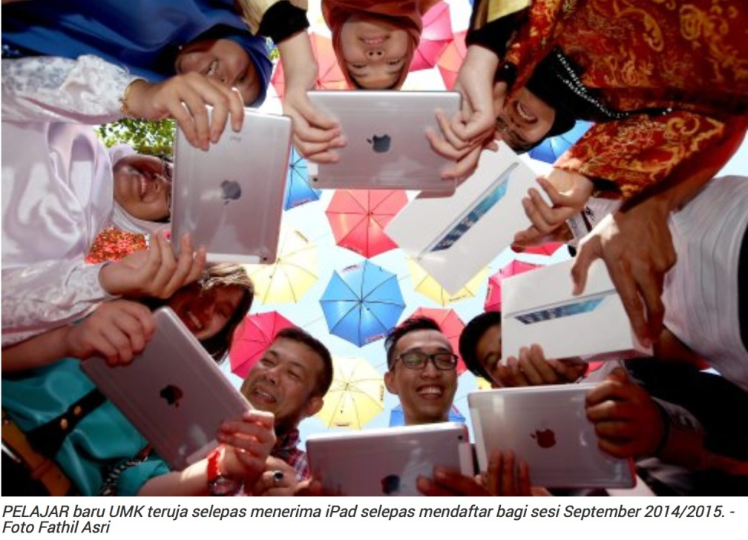
Diversities Research Summary Findings:
Young people have important concerns and responsibilities.
Everyday issues present profound and complex challenges requiring attention today
Youth are well-placed to develop new forms of activism and bring new energies and perspectives to everyday affairs.
The process of making the video transformed the students into active media users & creators.
Needed Good Practices -how do young people apply their ideas to their work, personal lives, families, community groups?

Slide 18
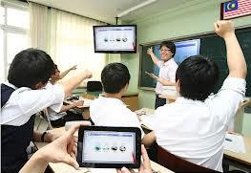
Designers: Media Literacy
Digital Malaysia
Utilise knowledge to aid speed decision making & sound judgment based on facts
Multimedia Super Corridor (MSC)
To transform administrative process and service delivery through the use of IT and multimedia
Malaysian Education Blueprint
Develop young Malaysians who are knowledgeable, think critically and creatively, have leadership skills and are able to communicate with the rest of the world
Ministry of Women, Family & Community Development
Adolescent health - Media

Slide 19
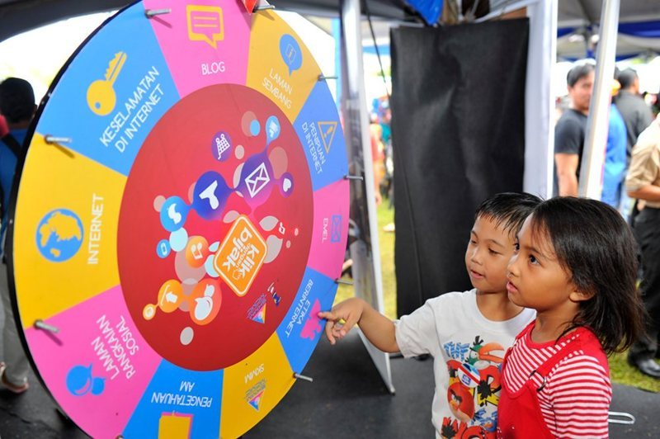
Designers: Media Literacy
Malaysian Communications and Multimedia Commission
Collaborative research
‘Klik dengan Bijak’ (“Click Wisely”) aiming for safety, security and responsibility.
‘League of creative teens’
National Service Programs
NGO & Child Movements, Cyber Security Malaysia
Research,
Outreach programmes
Media Safety workshop
DIGI, Maxis, The Star, NST, Panasonic, MDEC, FINAS
Research, campaigns, media workshops, NIE, RAGE

Slide 20
Arising Issues
The policy context - Digital Malaysia – but no clear and explicit agenda on media literacy
Lack official documents, plans & frameworks on media literacy
Media competences among children & youth –
under-researched
Learning, communication, play and identity experimentation – in the home – role of parents
Early sexualisation of childhood

Slide 21
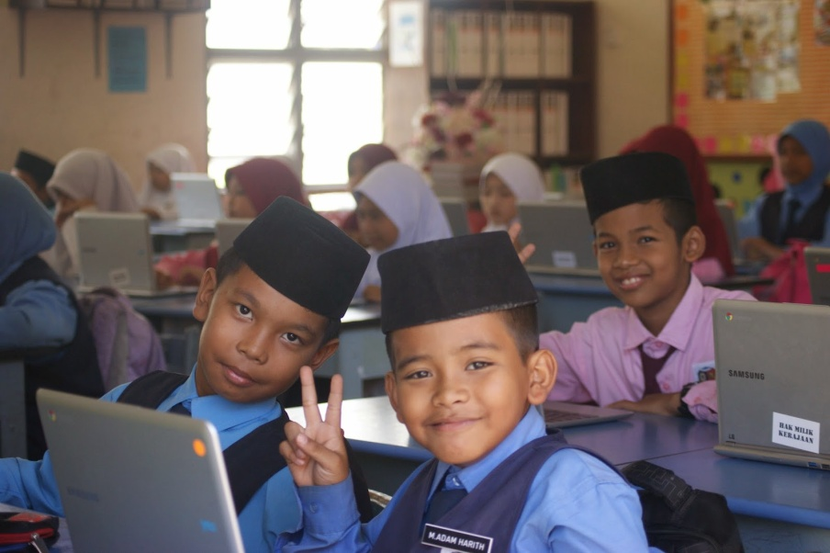
Arising Issues
Addressing the disconnect between children’s lifeworlds & school
Schools – crowded curriculum, exam-orientation; teacher factor: feedback or judgment
Consultative forum to bring together media literacy practitioners to explore, share and disseminate good practice.
The resource implications of quality media literacy are substantial.

Slide 22
Conclusion
Government as a platform - platform for citizens to help themselves and help others
Infrastructure for the field (Physical & Social infrastructure; Knowledge, skills, awareness, building community and drawing in residents.)
Engagement- the creatives, scholars, community leaders and developers who believe media literacy can be understood as the outcome of people’s interactions with and, especially, through media during the conduct of everyday life.

Slide 23
Thank you

