Slide 1
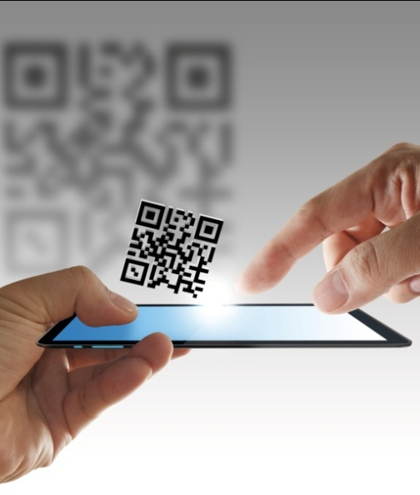
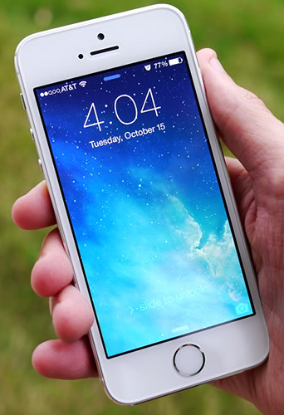
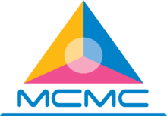




Privacy & Security
Challenges In
Mobile Communications
17 February 2015

Slide 2

FULBRIGHT - MCMC GRANT

Slide 3
A Connected World

Slide 4

A Connected World
Global:
WeChat growth with an active user base increase 156% (between Q1 2013 – Q3 2014)
Malaysia:
WeChat growth with an active user base increase 1,187% (between Q1 2013 – Q3 2014)
Malaysia:
Smartphone Sales Volume = 8.5 million (2014)
Apple:
Tracking about 1 billion App downloads a month (2012)
Malaysia:
Nine out of ten smartphones sold are Android-based (2014)
Vietnam:
24% of users are accessing the Internet purely on smart devices
Malaysia:
Aggregated Internet Bandwidth Consumption
Jan - June 2014: 306,970 Mbps
Jan - Dec 2013: 349,277 Mbps
ASEAN:
Mobile Data Penetration: 28.4%
Compound Annual Growth Rate of 12.5% next 5 years
Malaysia:
One of only five countries in the world where smartphone usage exceeds that of computers – 51% vs 29% (2014)

Slide 5
Apps: Growth & Downloads
Total Apps Available
Total App Downloads
Number of downloads
Number of smartphone users

Slide 6
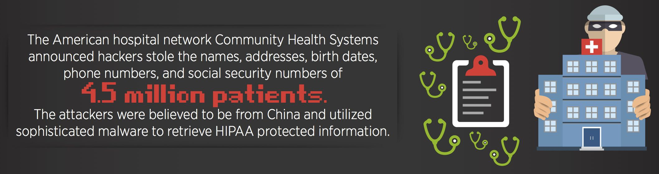
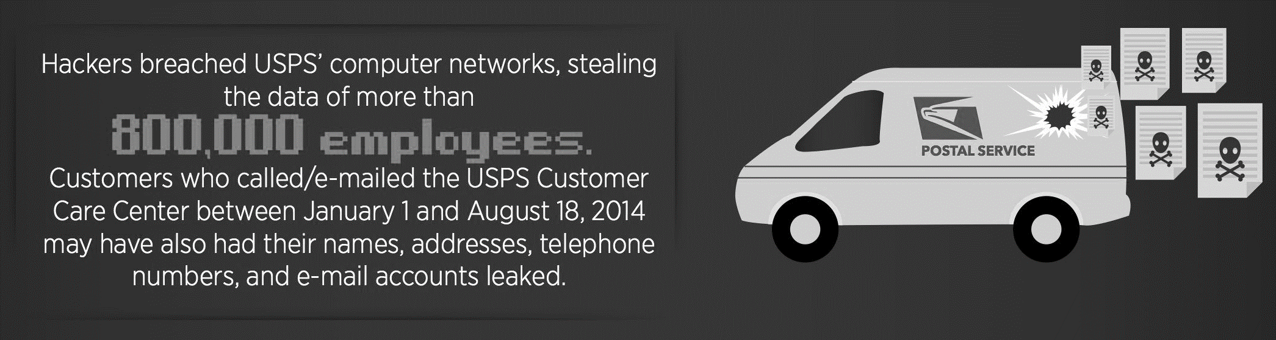
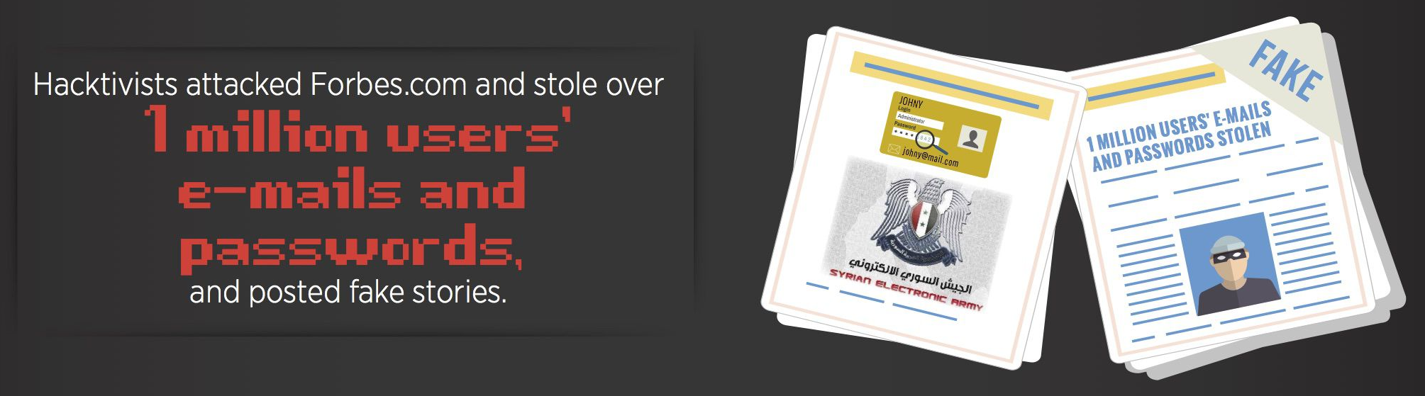
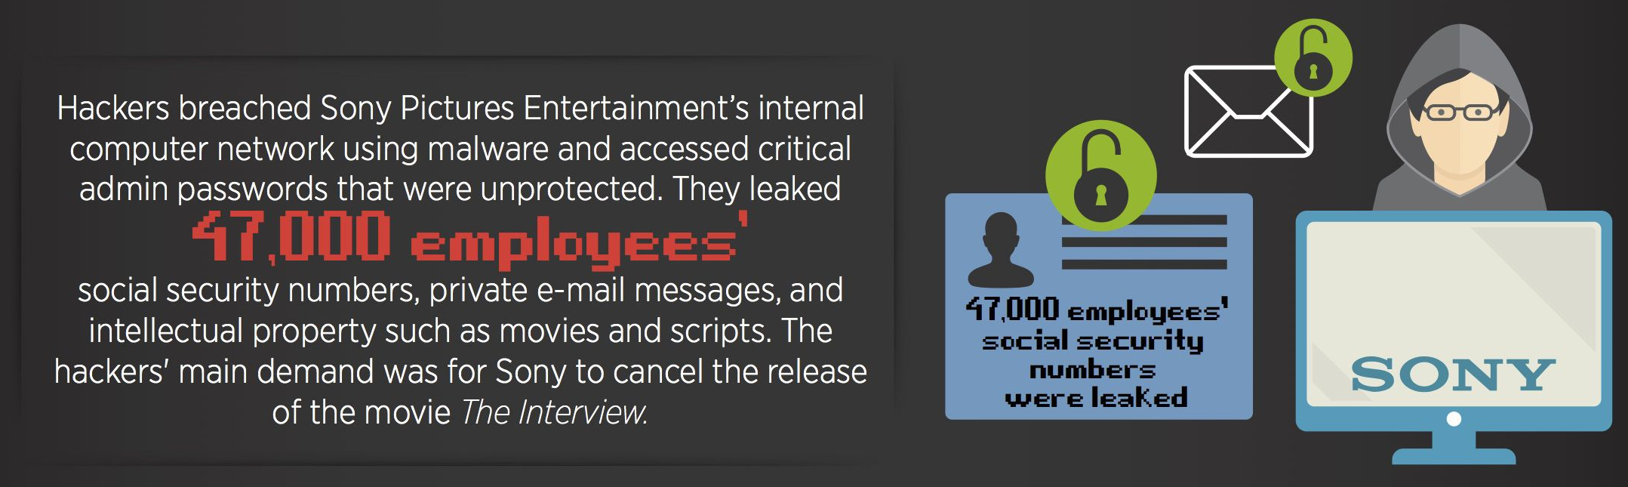
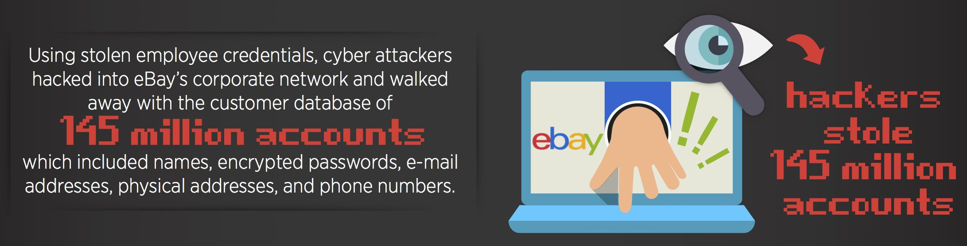
Privacy & Security Breaches (1)
Names..Addresses..Phone Numbers..Social Security Numbers..Emails.. Passwords..Intellectual Properties…….

Slide 7
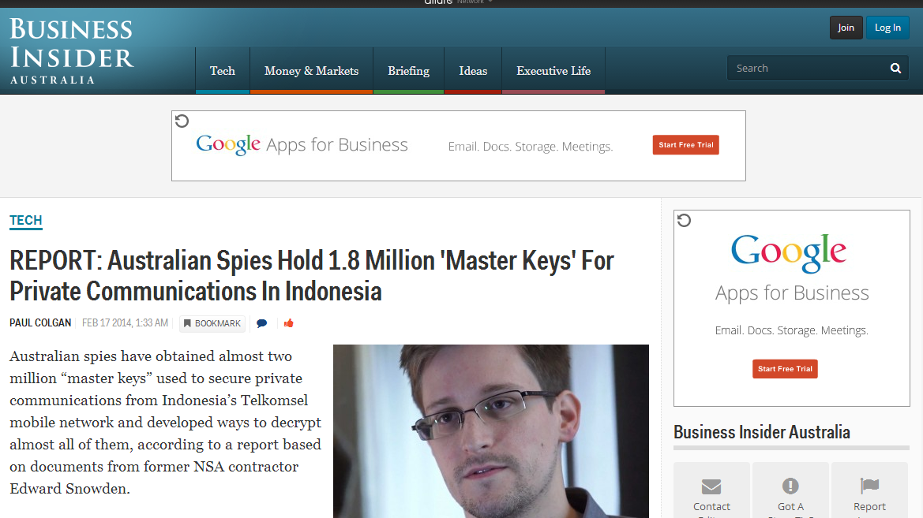
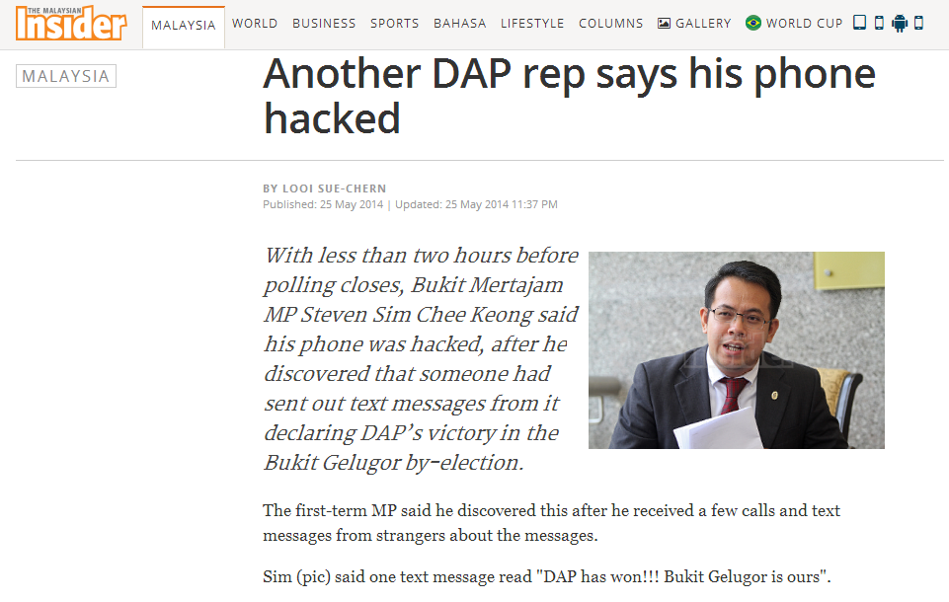
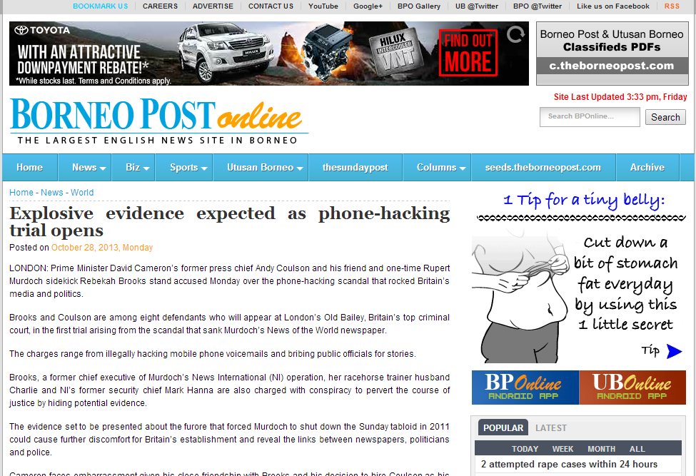
Privacy & Security Breaches (2)
United Kingdom:
More than 40 per cent of UK businesses have suffered a security breach from work mobile phones in the past 12 months (2014) according to British Telecoms
Chinese spies read Australian MPs' emails for a year: report
Reuters @ 27th April 2014
Indonesia's ties with Australia turn to ice over phone tapping
Reuters @ 20th Nov 2013
Malaysia Summons Singapore Envoy as Spying Claims Widen
Bloomberg @ 26th Nov 2013
According to British telecom firm BT, 98 percent of U.S. firms allow employees to use personal mobile devices for work. However, organizations struggle to manage mobile devices, develop effective policies and controls, and create a secure environment that works for both the business and the employees.

Slide 8

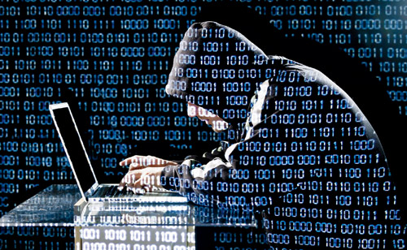

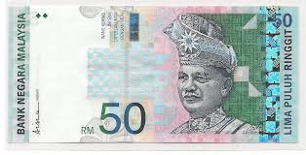


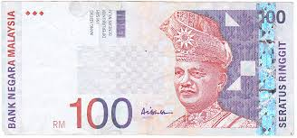
Consequences
Disruption in functioning of the system
Data/ Info Loss
Economic loss
Criminal & Destructive Elements
Diplomatic Tension

Slide 9
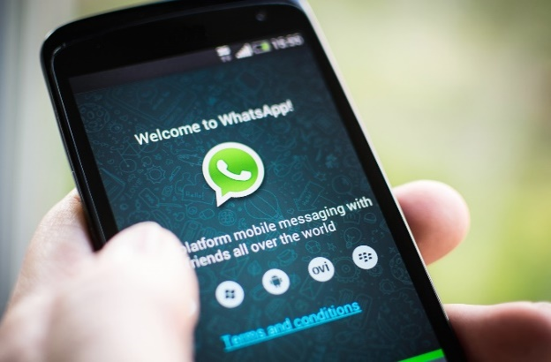
Industry Direction…
Apple & Google: Oct 2014
On Thursday, the FBI’s director, James Comey, decried the company’s decision to offer similar tools on mobile devices running iOS 8.
“With Apple’s new operating system, the information stored on many iPhones and other Apple devices will be encrypted by default,” Comey told the Brookings Institute in Washington DC.
“Shortly after Apple’s announcement, Google announced plans to follow suit with its Android operating system. This means the companies themselves won’t be able to unlock phones, laptops, and tablets to reveal photos, documents, email, and recordings stored within.”
MegaChat & Chadder: Jan 2015
WhatsApp: Nov 2014

Slide 10
mTouche: An Overview

Slide 11
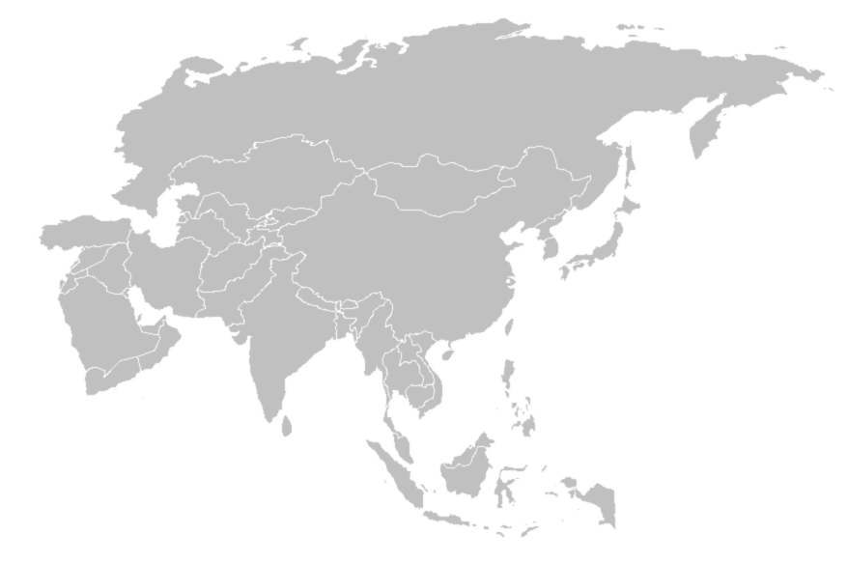







mTouche: Overview
Established in 2002. A MSC status company listed on the ACE Market Bursa Malaysia
Focuses on the provision of mobile value-added services to more than 40 Mobile Network Operators reaching out to more than 600 million subscribers
Operations in Malaysia, Singapore, Indonesia, Thailand, Vietnam, Cambodia dan Hong Kong
Thailand
Hong Kong
Singapore
Vietnam
Indonesia
Cambodia
Key Business Areas
1
2
Data & Mobile Security
To provide data and mobile security solutions
3
Mobile
Content & Solution
To provide services direct to end users, and
solutions/ services to corporate clients or telcos
Strategic Business
To explore opportunities in Internet of Things (IOT)

Slide 12
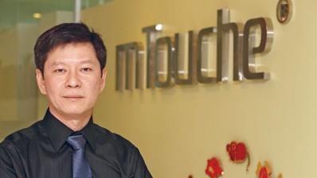
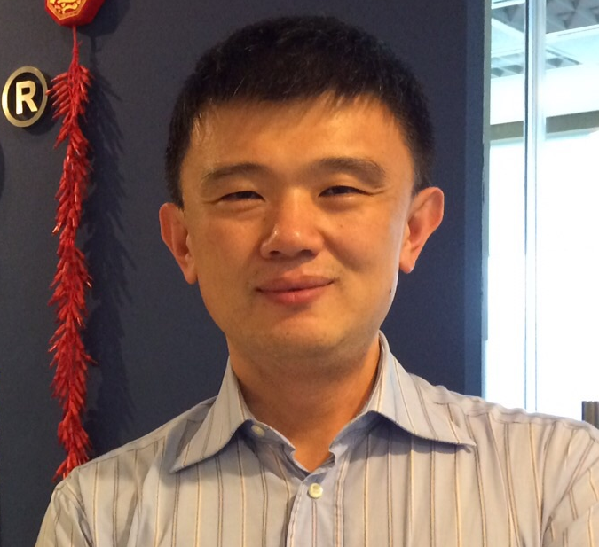
mTouche: Key Talent
Kenneth Kong
Chief Technology Officer
Bachelor Degree (Computer Information System) & Master of Business Administration (Finance) from Hawaii Pacific University
2000 – 2013: Worked at the Microsoft Corporation’s HQ in Redmond, Washington
Held several management positions in Windows, Microsoft Customer Support and Developer divisions
Substantial experience and knowledge in software engineering and various technologies in operating system, web applications, Cloud applications and Business Intelligence
Vast experience in the field of cyber security in communications
David Hsu
Chief Commercial Officer
Bachelor of Arts from the University of British Columbia, Canada & designation in Software Product Management from the University of Washington
15-year career at Microsoft Corporation in Redmond, Washington
Senior Program Manager in Microsoft Azure. Experience in identifying new business opportunities and turning them into products, market sizing, developing partnerships, marketing and communications, and launching products
Performed product planning in Microsoft Customer Service and Support. Part of the leadership team responsible for transforming support.microsoft.com
Managed the planning for Microsoft Developer Network (MSDN). Part of the team that launched Visual Studio 2012

Slide 13
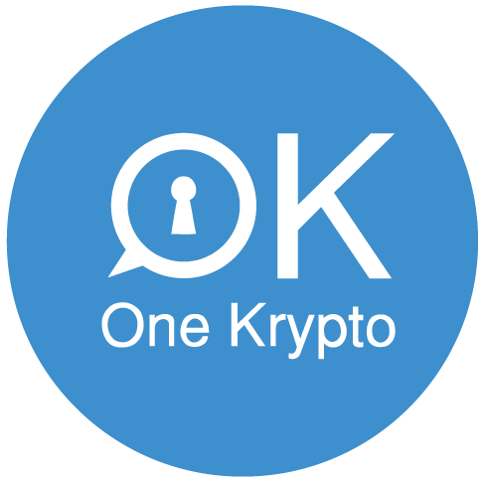
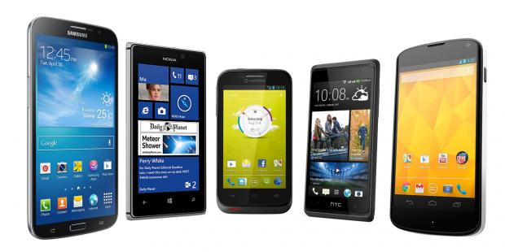






One Krypto: Overview
One Krypto:
A secured mobile communication application with comprehensive encryption solution
(AES-256 Military Grade Encryption Technology)
Platform
Operating
System
Features
Chat
Email
Voice (VoIP)
Notes

Slide 14
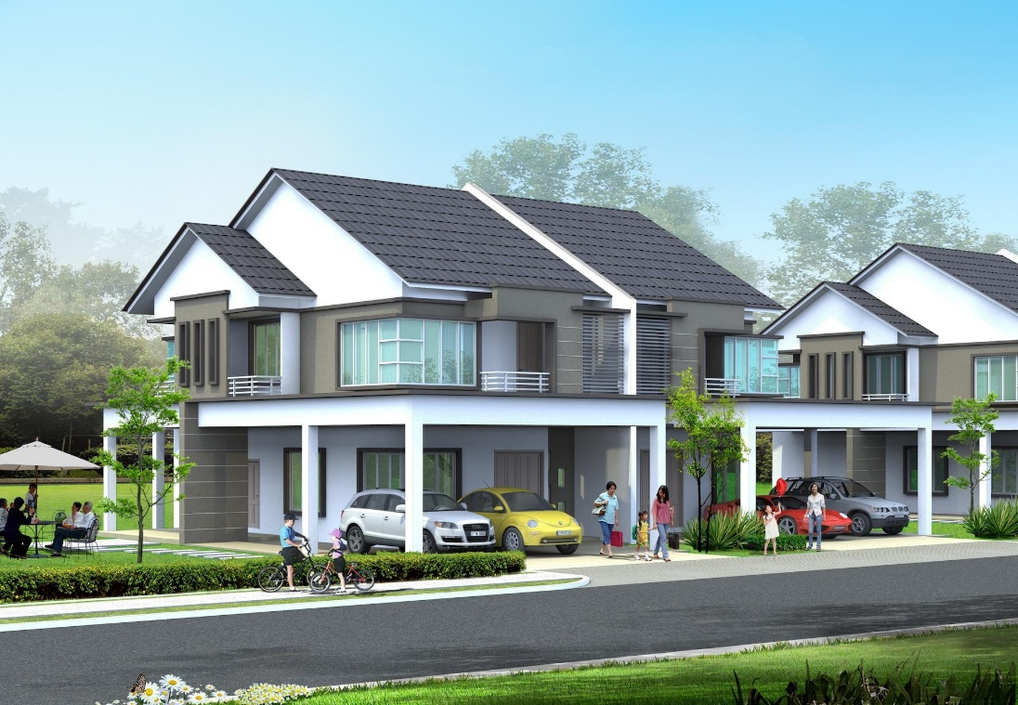

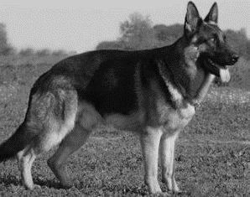
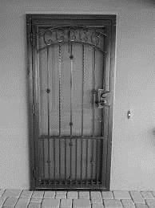
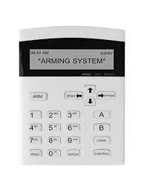
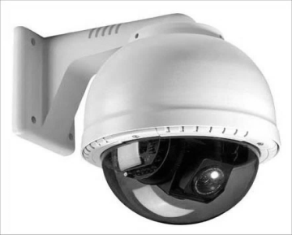
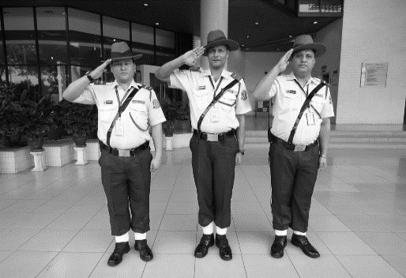
Privacy & Security

Slide 15
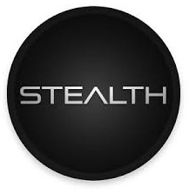
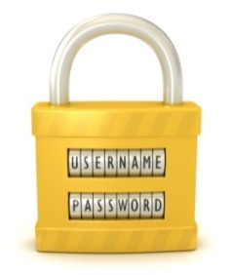

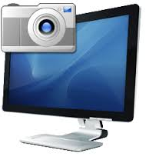
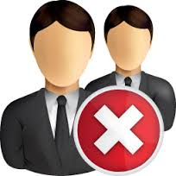



One Krypto: Privacy & Security
Stealth
Password
Encryption
Screen Capture
Conceals OK icon
Password to access OK
OK data encrypted
OK screen capture disable
No Trace
Phone Book
Auto Expiry
Manual Reset
OK self-destruct
Hidden phone book to keep your private contact details
Encryption key expires automatically and reset every 30 days
Enable manual reset when key is compromised

Slide 16
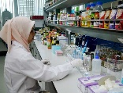


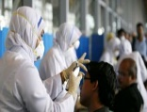







One Krypto: Users
Organisations which communicate and handle confidential information eg: R&D, hospitals, law firms
Government Officials & Agencies, Security, Enforcement & Military Personnel
Professionals who deal in highly confidential and sensitive information, environment and clients eg: analysts, researchers, lawyers, doctors
Privacy concious public
Hi Doc. Got the lab results. Great news! Mrs. B is pregnant. Doc X
Hey Mr. Banker. Am thinking of merging our Vietnam & Thailand operations. Any thoughts? Mr. CEO

Slide 17
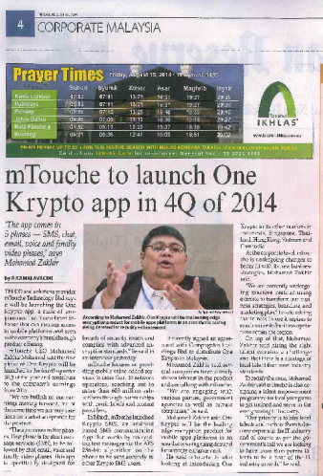
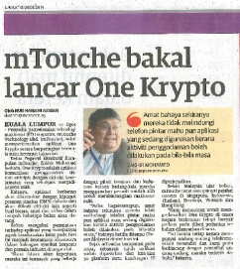
One Krypto: Media
Malaysian Reserve @ 15 Aug 2014
Utusan Malaysia @ 15 Aug 2014
Bernama @ 9 Feb 2015

Slide 18
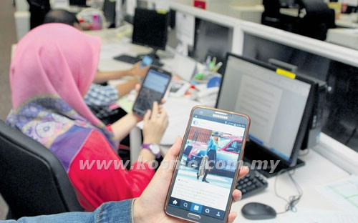
Data & Mobile Security Solutions
Mobile Device Management
A Mobile Device Management (MDM) solution for organisations to manage mobile devices within their premises:
Mobile Device Management
Mobile Application Management
Mobile Content Management
Mobile Data Security Management
A Mobile Data Security Management solution allowing user organisation to protect data integrity and privacy:
Data Protection: Protects all the files and data including photo, video, documents and contacts, on the mobile devices to enable access permission restriction and encryption to ensure data integrity and security
Mobile Security: Password protected, intruder detection and device tampering prevention, remote reset or wipe data on devices
Tracking and Monitoring: Tracks and log unauthorized activities
KUALA LUMPUR – Persekutuan Majikan-Majikan Malaysia (MEF) mencadangkan supaya satu garis panduan baharu berhubung penggunaan telefon pintar dilaksanakan di tempat bekerja bagi mengelakkan produktiviti mereka terjejas.
Pengarah Eksekutif MEF, Datuk Shamsuddin Bardan berkata, garis panduan itu penting kerana terdapat majikan yang terpaksa membayar gaji lebih masa pekerja kerana mereka lewat menyiapkan kerja di­sebabkan penggunaan telefon pintar semasa melakukan tugas-tugas di pejabat.
“Ini menyebabkan ada syarikat tertentu yang terlalu ekstrem dengan melarang pekerja mereka menggunakan telefon pintar ketika waktu bekerja,” katanya ketika dihubungi ­ Kosmo! Ahad semalam.

Slide 19
THANK YOU
mTouche Technology Bhd
Suite 39-06 Menara Citibank 165 Jalan Ampang 50450 Kuala Lumpur Malaysia
Tel: +603 – 2166 0018 Fax: +603-2166 1028
www.mtouche.com

