Slide 1
Fulbright MCMC mHealth in Malaysia
Claire Cravero
claire.cravero@gmail.com

Slide 2
Introduction
New Hampshire native [Boston area]
Johns Hopkins University class of 2011
Studied International Relations and Public Health
Spent one year at Sciences-Po in Paris.
Public health internships in New Delhi, Dakar, and Honduras
United States Peace Corps – 2.5 years in Senegal (West Africa)
Program Analyst – Dimagi, Inc (mHealth Company)
Fulbright researcher c/o Dr. Adeeba Kamarulzaman
Notes:
-I grew up in New Hampshire, physicians for parents but never wanted to be a doctor.
-Developed interest in global health and the intersection between public policy and health
-Studied international relations (certificate in race and ethnic studies (one of the reasons I find Malaysia so fascinating), also concentrated my studies on public health
-I had public health internships in New Delhi (NGO), I worked for UNAIDS regional office in Dakar Senegal, and then with another NGO in Honduras (low resource settings)
-After college I served in the United States Peace Corps – I was a health volunteer in a village – no water, no electricity – became interested in public health when my village got electricity and I started seeing how community health workers used their phones to improve public health
-I then worked as a program analyst for an mHealth software company called Dimagi based out of Boston
-Now I am a Fulbright researcher focusing on mHealth for marginalized populations in Malaysia

Slide 3
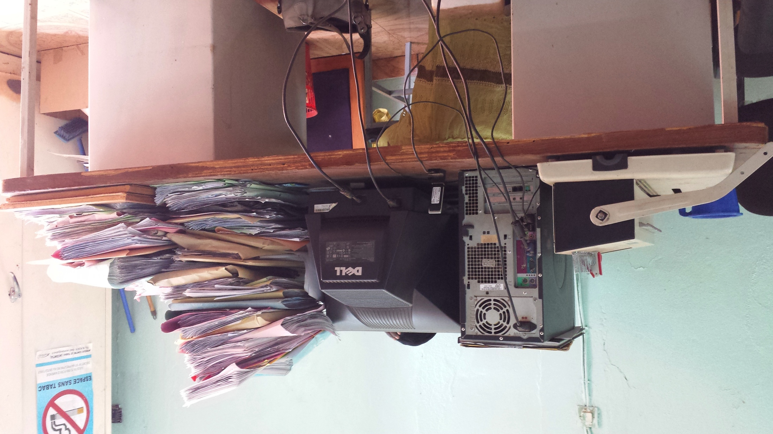

Slide 4
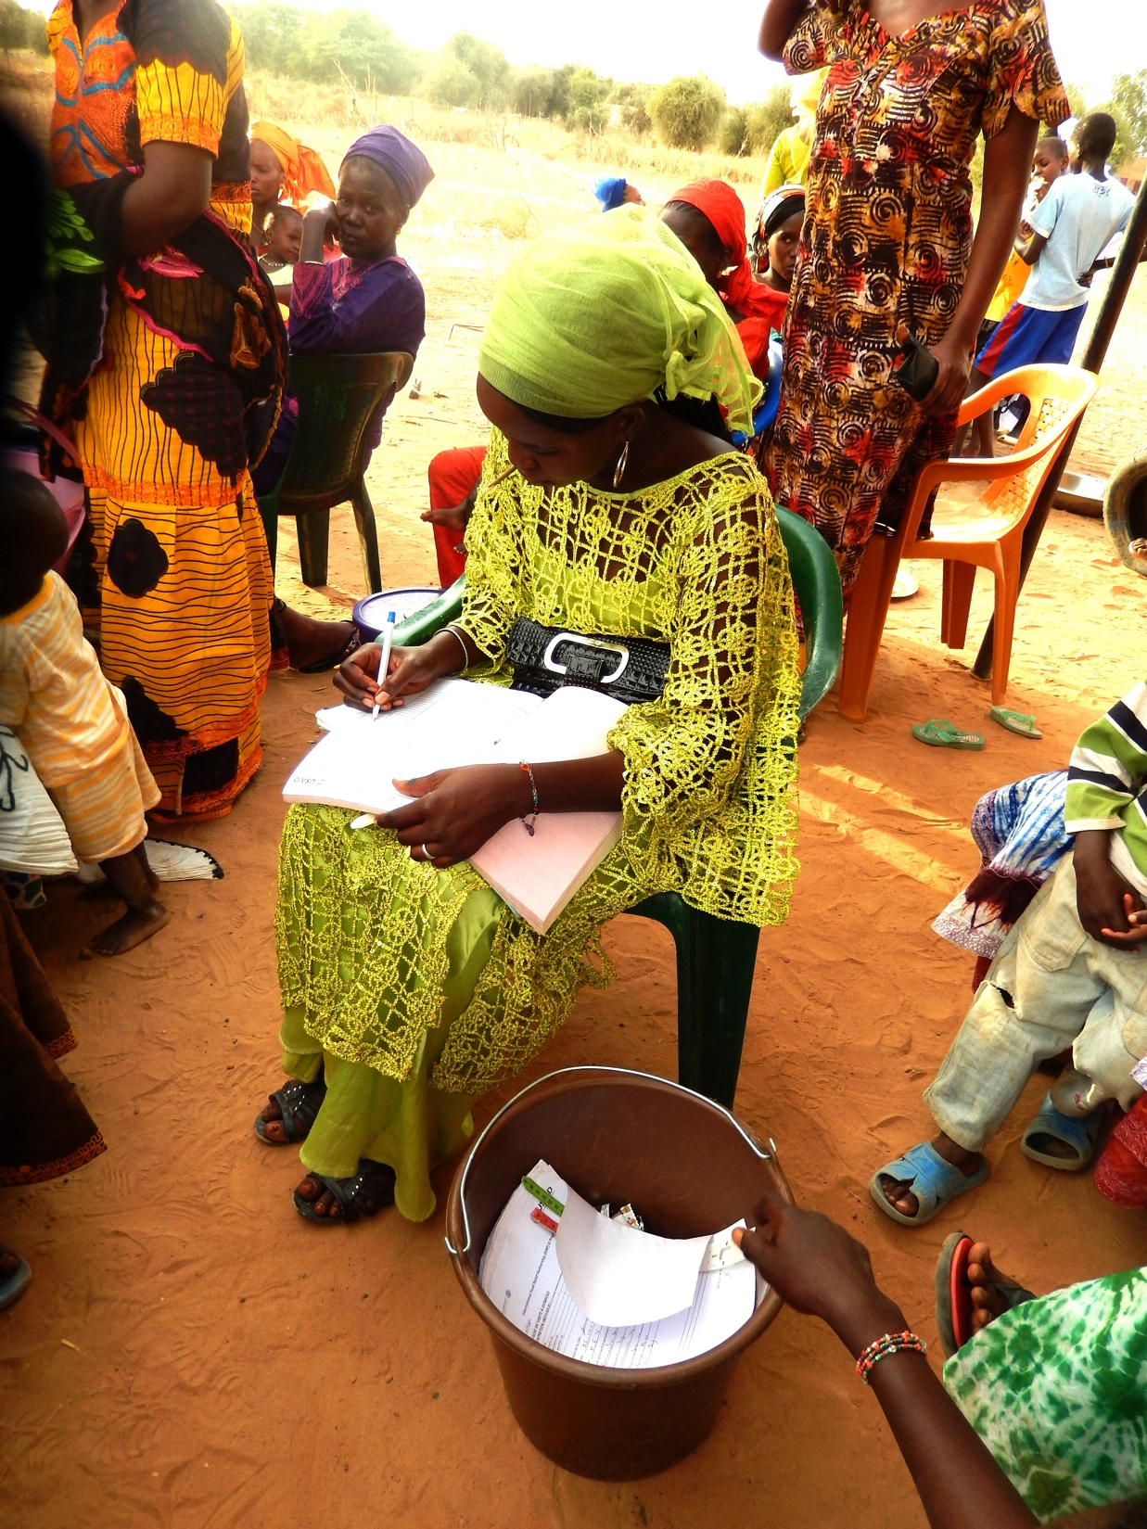
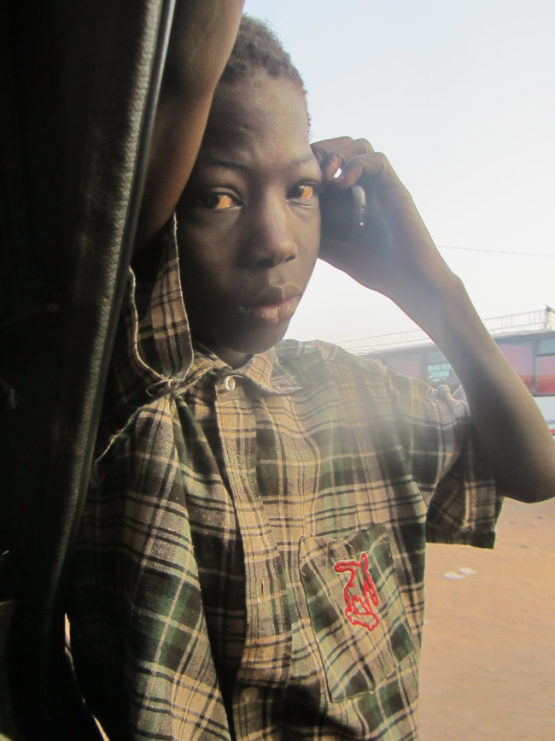

Slide 5
Quiz:
What is the definition of eHealth?
What is the definition of mHealth?
Notes:
People get confused about these terms – what are we talking about here. Who can define these for me?

Slide 6
eHealth
mHealth
Notes:
Originally was interpreted as just traditional computing as applied to medicine – this has expanded – wide range of devices, both health care provider and patient owned technologies for supporting health improvement – WHO definition: eHealth is the cost-effective and secure use of information and communications technologies in support of health and health related field, including health care services, health surveillance, health literature, and health education, knowledge and research”
eHealth encompasses smaller more specific areas within this broad space – these discrete pieces include mobile health, as well as health information systems, telemedicine, and distance learning (eLearning).

Slide 7
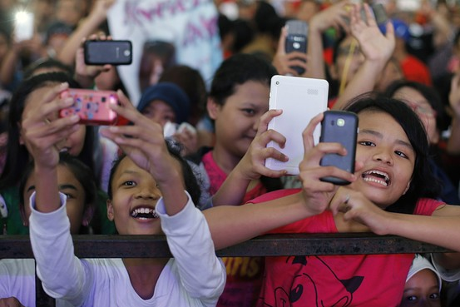
What do ASEAN countries have in common w/r/t mHealth?
YOUTH CULTURE
Not everyone is moving to the city
Disease convergence
Gaps in data
Source: http://www.ericsson.com/res/docs/2014/regional-appendices-sea-final-screen.pdf
Photo Source: http://blogs.wsj.com/searealtime/2014/07/07/indonesian-youths-size-up-presidential-hopefuls/
Notes:
From ericsson source:
[pg 2] - Youth culture - the youth segment (those aged 10-24 years) is among the largest globally. It is especially big in the developing countries of South East Asia and Oceania. There are more than 170 million young people in this region. The youth population in Philippines is at 31 percent, while in Malaysia and Indonesia this figure is at 28 percent and 26 percent respectively. The region’s youth segment is crucial in driving the adoption of apps as well as the uptake f smartphones and mobile data services, particularly in the developing markets. A higher proportion of youth in the region owned smartphones compared with adults in 2013. The youth segment is also more active in using their smartphonse for multiple purposes, from basic services such as voice and SMS, through to internet browsing, social networking and video streaming.
[pg 3] This trend is not stopping any time soon → the younger demographic are tomorrows doctors and policy makers
[pg 3]Another major similarity between most ASEAN nations: Despite the urbanization trend, a significant proportion the the population will continue to live in rural areas in 2019. ICT can also improve people’s lives in these places by providing services that meet their needs, and extending the availability of services that could not previously be offered outside of cities → People in rural areas are gaining access to critical mobile tools too. Project and program designers should pay close attention to this fact.

Slide 8
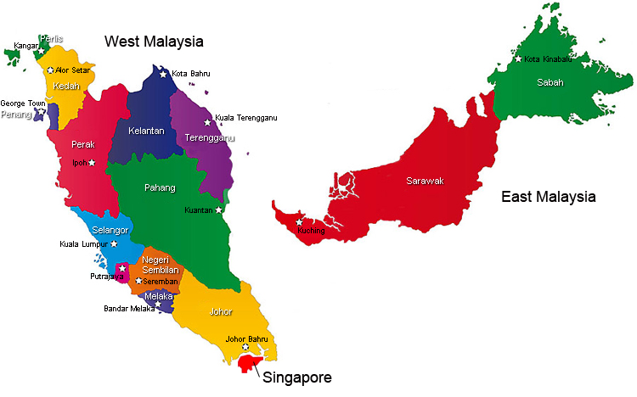
mHealth in Malaysia (i.e. Why am I here?)
High rate of mobile use, telecom presence, decent broadband connections, lack of implementing partners
Disease convergence
Vulnerable populations
Enthusiasm on the part of the Ministry of Health for m&eHealth
Malaysia is grouped by the WHO as an upper middle income country
International “donors” are few and far between → Fewer donors → fewer pilot projects → pressure on public/private partnerships
Notes:
My work has focused on vulnerable populations – I think mHealth is unique in it’s ability to reach these pockets of highly vulnerable populations → Why I have found a good home with CERiA
→ looking at how people use their phones here – how do vulnerable populations interact with their phones → how do TARGET groups interact with their phones

